Slide 1

Life of a Grad

Slide 2


Subject: Congratulations on Your Selection at NatWest Group!
Dear Tanishq,
We are thrilled to inform you that you have been selected as a candidate at NatWest Group!
Your application impressed us greatly, and we are confident that you will be a valuable asset to their team.
Congratulations on this exciting opportunity!
Sincerely,

Slide 3
Subject: NatWest Group Interview Success – Congratulations!
Dear Tanishq,
Congratulations! We’re pleased to inform you that you’ve progressed to the interview round for your role at NatWest Group.
Your application stood out, and we encourage you to showcase your skills and experience during the interview.
Best regards,

Slide 4

[ ]

Slide 5
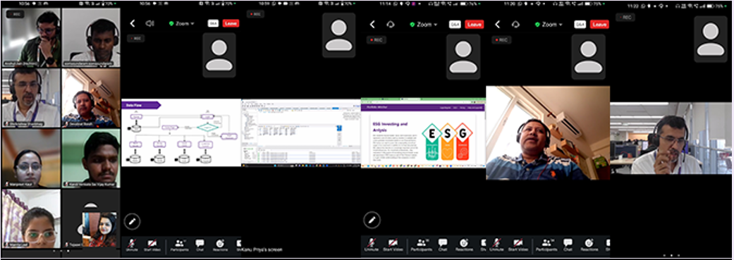
Glimpses of Bootcamp

Slide 6
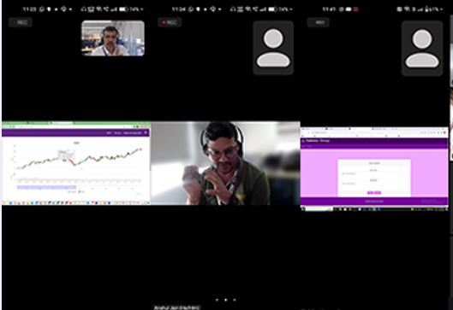
Glimpses of Bootcamp (cont’d)

Slide 7
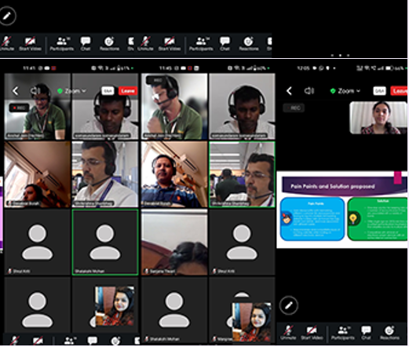
Glimpses of Bootcamp (cont’d)

Slide 8
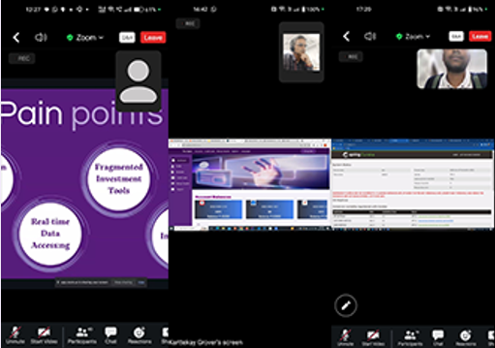
Glimpses of Bootcamp (cont’d)

Slide 9
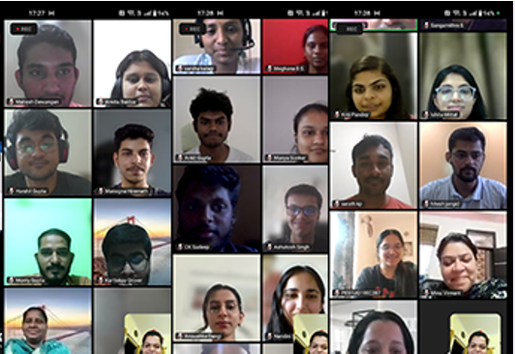
Glimpses of Bootcamp (cont’d)

Slide 10
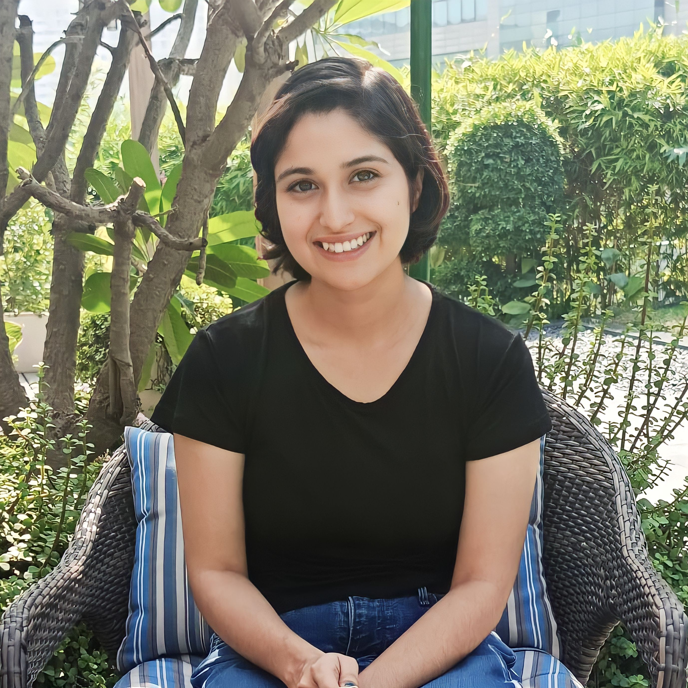
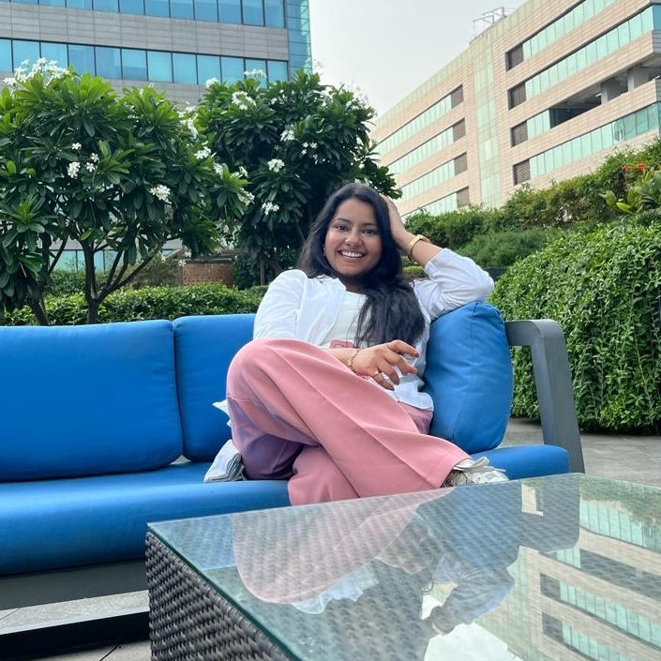
Skit: Graduates to Creators
Our Engineering journey

